Slide 1

Inclusion Team
‘Meet and Greet’
Monday 23rd September 2019

Slide 2

What is ‘inclusion’?
Inclusion means EQUAL OPPORTUNITIES for ALL.
Including all pupils in education whether they are physically disabled, have learning difficulties or other barriers that mean they need extra support in school.
Best outcomes for all pupils.

Slide 3
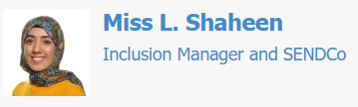
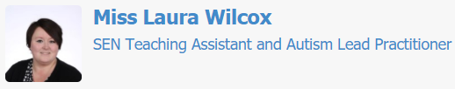

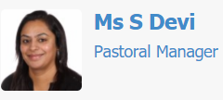
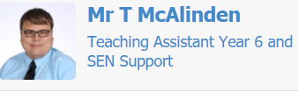
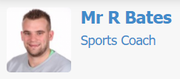

The Inclusion Team

Slide 4

Miss Shaheen
Inclusion Manager/SENCo
Work closely with the Inclusion Team to ensure effective communication.
Work with parents, staff and specialist support agencies to identify areas of difficulty for SEND pupils and how we can support these pupils in school.
Building strong partnerships with SEND pupil’s parents, informally and formally.
Ensuring pupils with SEND access the curriculum, physical environment and extra-curricular activities.
To make sure SEND pupil transition to secondary school is an effective and informative process.

Slide 5

Ms Devi
Pastoral Manager
To provide support that meets the differing needs of all children so that each child is equipped with the skills to cope with life.
To support and work alongside parents in addressing pastoral concerns impacting on their child’s learning and development.
To provide specialist counselling to support individual children, listening and talking to children who may need support in a variety of pastoral issues, for example, self-esteem and confidence, bereavement, managing feelings, anxieties/worries, separation and developing social and friendship skills.
To work with a range of stakeholders, parents, support staff, outreach agencies and other schools to ensure the continuity and progress of individual pupils.

Slide 6

Grab and tea/coffee and come and say HI!
Please take a copy of the draft SEND Policy- any feedback would be appreciated ☺

