Slide 1
Back to school
Changes & New Rules

Slide 2
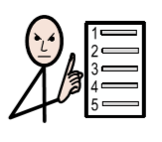
There will be some new rules in school.
New rules

Slide 3
The new rules will keep us safe from the virus.

Slide 4
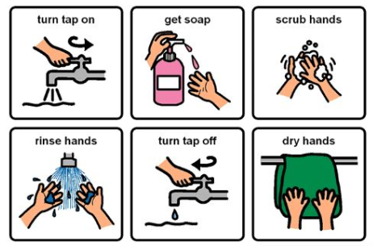
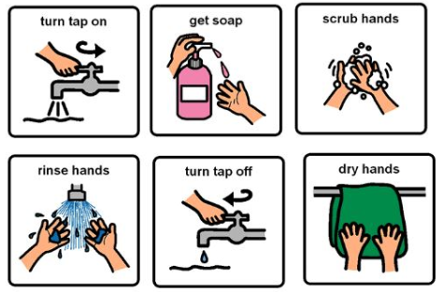
Washing hands
Adults will remind you to wash your hands regularly.

Slide 5
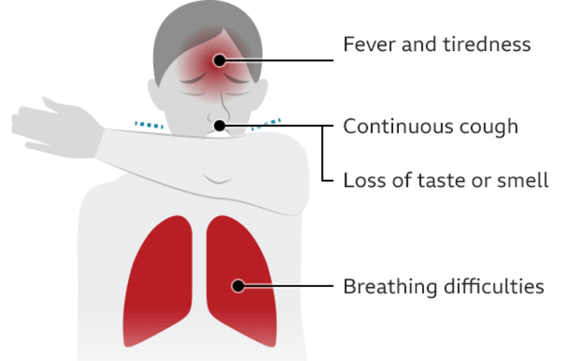
Feeling poorly
Tell an adult if you feel poorly.
Self-isolate for 10 days

Slide 6
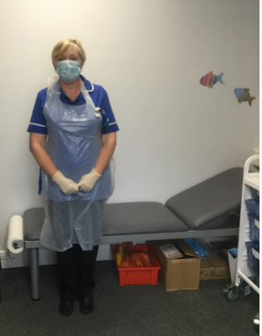
Feeling poorly
Mrs Pegg, our school nurse will take care of you help if you feel sick.

Slide 7
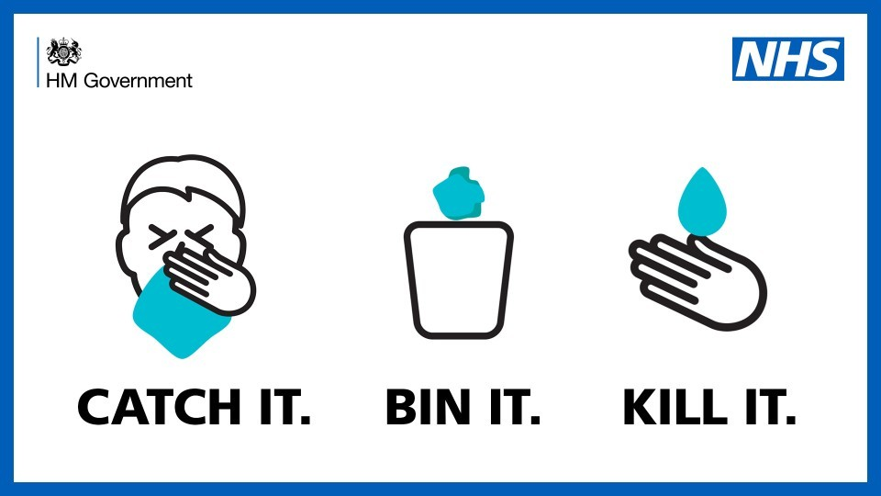
Sneezing, coughing, tissues and disposal
Posters around school and in class will remind you to keep good hygiene.

Slide 8
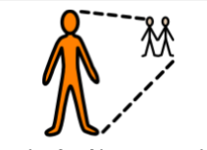
Social distancing
2 metres
Protect yourself and others.

Slide 9
No touch
No hugs
No rough play
No handshakes

Slide 10
No sharing
You will have your personal pencil case/tray with the stationary you need.

Slide 11
Changes
Sometimes change makes us feel worried or sad, that’s ok.
Everyone feels worried sometimes.
If you are worried you can tell someone who cares for you, a trusted adult. They will listen to you and help you to be less worried.

Slide 12
Changes
I might have different playtimes and lunchtimes. This is okay.
I might sit in a different seat. My teacher will show me. This is okay.

Slide 13
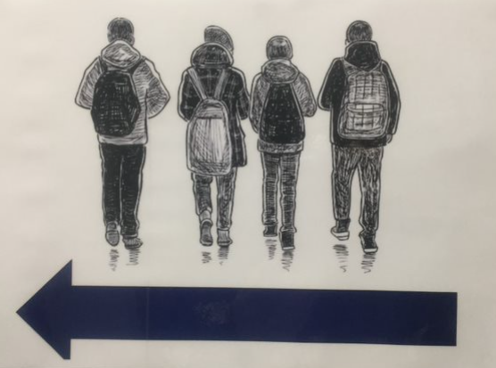
Changes
My classroom might look different. This is okay.
I might come into school in a different way and leave school in a different way. There will be a one way system in school. This is okay.

Slide 14
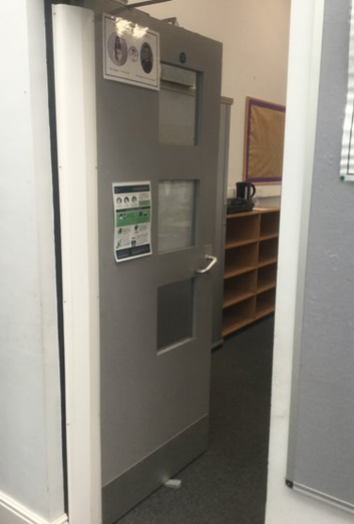
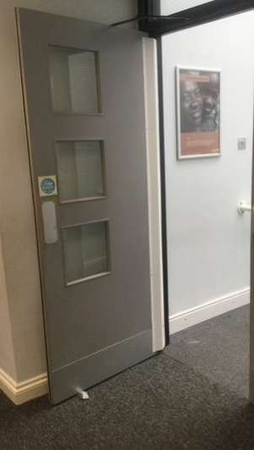
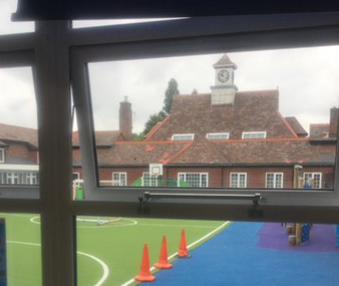
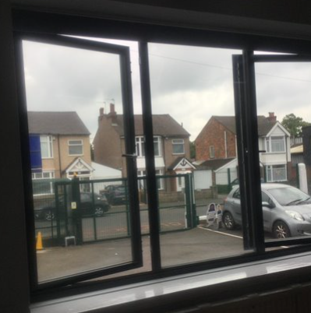
Changes
Classroom windows and doors will be kept open to allow fresh air to circulate.

Slide 15
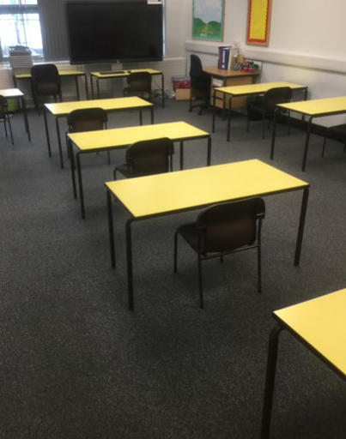
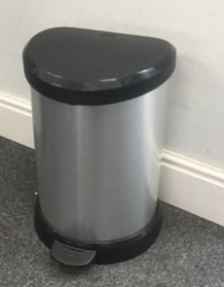
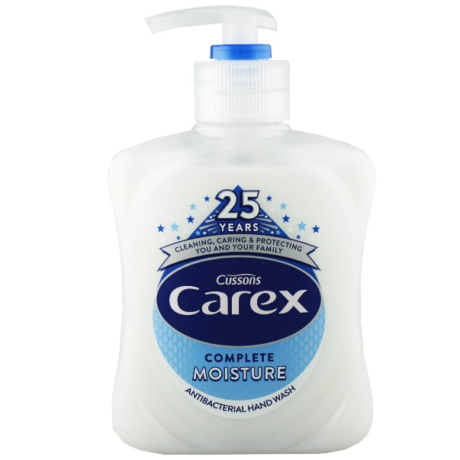
Classroom changes

Slide 16
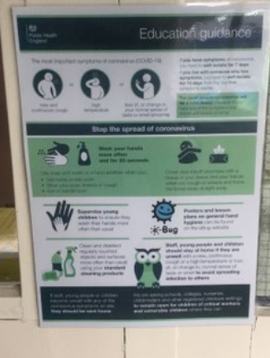
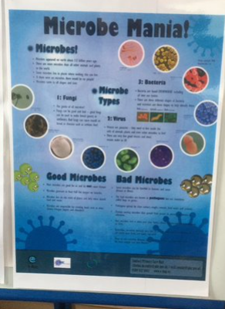
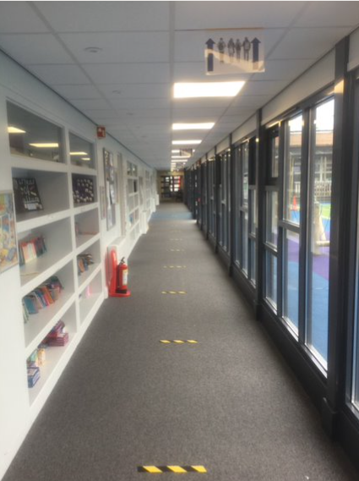
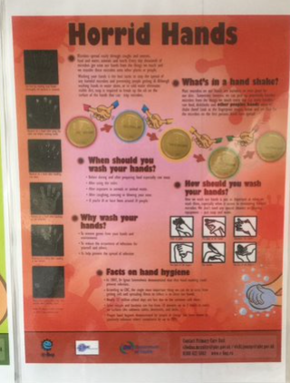
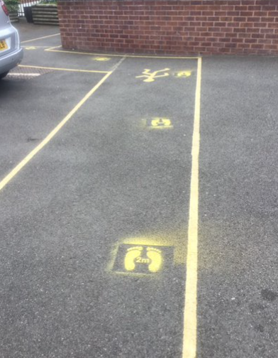
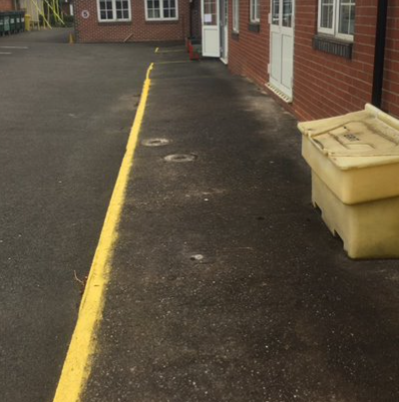
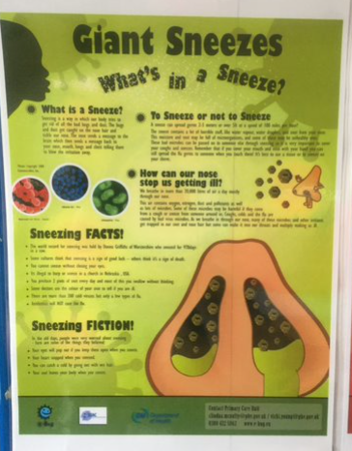
School building changes

Slide 17
Changes
There might not be assemblies.
Not all of my friends will be at school at the same time as me. This is okay.

