Slide 1
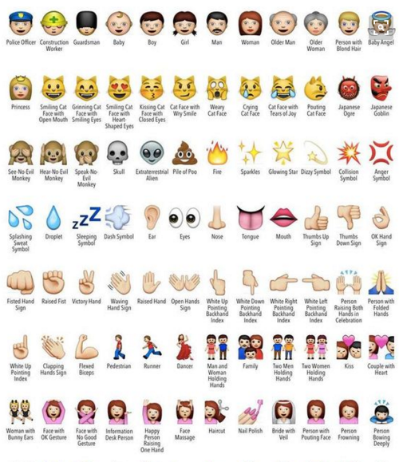
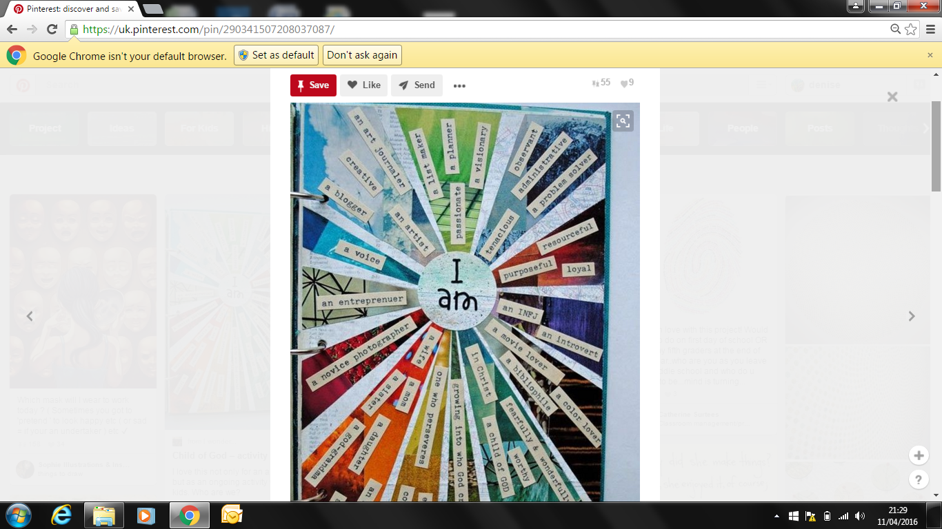
Getting to know you
Year 7, as we can’t meet you face to face just yet, we’d like you to think about how best to tell us all about yourself when you arrive. We’d really like you to be creative and use images and words to describe yourself to us. We’ve put two suggestions below that will start you off. Please bring this work back in September, along with the letter to your form teacher, when you come to join us at Washwood Heath Academy in Year 7.
Task 1
Representing me
Draw a small mind map of everything that represents your personality.
Add small symbols to illustrate your favourite objects.
You could even use emojis if you like to help describe yourself. Make sure you explain why you chose those particular ones!

Slide 2

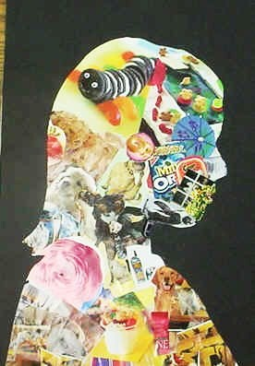
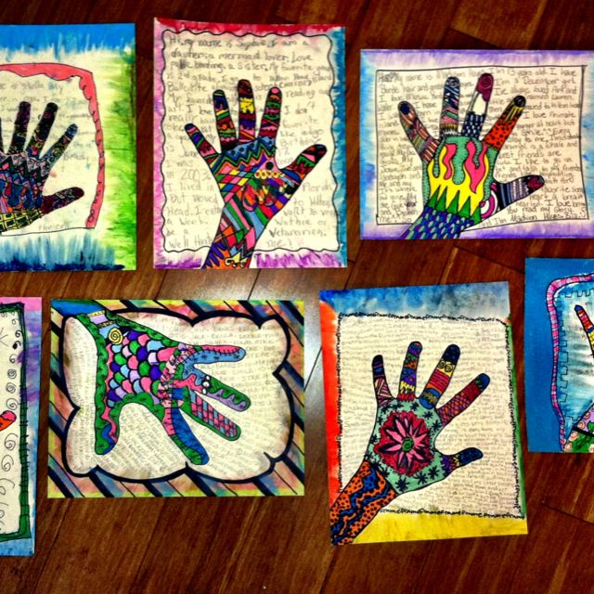
Representing me collage
Task 2:
Another way to describe yourself is in a collage – a collection of images.
Draw an outline of a head or draw around your hand.
Aim to fill all the spaces with ideas to represent you.
Use magazines, adverts, newspapers and internet images of your favourite objects or words. You can even draw in them if you prefer.
Cut and stick images to produce a collage of a face or hand made up of your favourite things!

