Slide 1

Supporting your child with reading
What to do at home

Slide 2

This is a guide to help parents and carers work together with the staff at Thornton to help all our children to make the best progress. On each slide there is an icon like this that you can click on to hear the audio.
If you have further questions, do not hesitate to talk to your child’s class teacher, or speak to the staff on reception to set up a meeting with Ms Evans the English Lead.

Slide 3
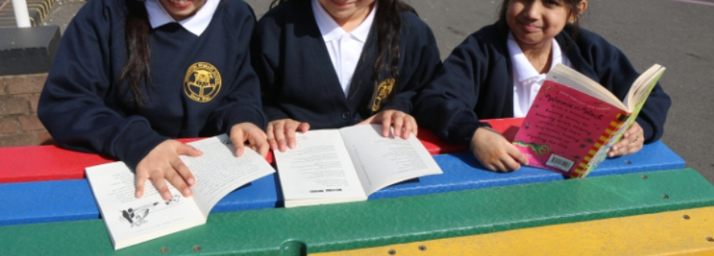

Being able to read is an essential skill that unlocks so much of the world. At Thornton, Reading confidently has a very high priority. If our children can’t read, they can’t access much of the learning in school. If they can’t read, they also miss out on a lot of enjoyment.
Although we work very hard in school to teach your children to read and enjoy books, what happens at home can be even more important. We have made this short presentation to give you some ideas to help you to support your child’s progress in Reading. Working together, we will give your children the best possible chance of being successful.

Slide 4
When a child is learning to read, we use phonics to teach them how to decode the print. This means we look at the sounds in a word. We teach the code of letters that represent sounds. For example:
In the word ‘dancing’ we have the sounds /d/ /a/ /n/ /s/ /i/ and /ng/
Any time a child is unsure of how to say a word, you should encourage them to ‘sound it out’. Look for the smallest sounds. Break the word down into these sounds and then blend it together into a whole word. This is the strategy to use on unfamiliar words no matter how old or otherwise confident your child is. There will always be new words that need decoding.
For example, if your child is stuck on the word ‘brain,’ try breaking it down.
b r ai n

Slide 5
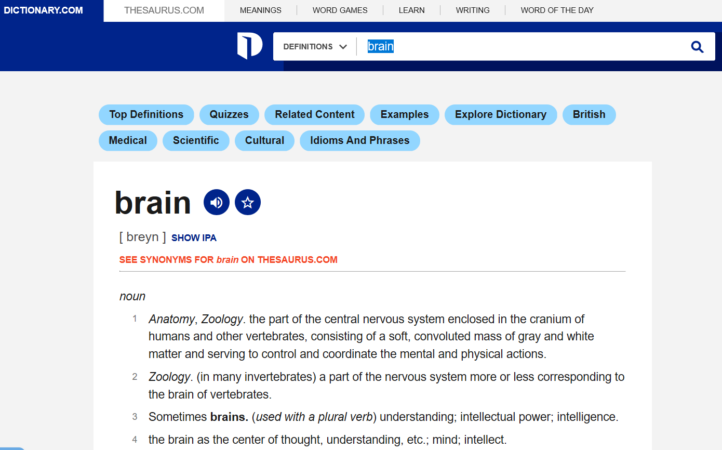
If your child is stuck on the word ‘brain,’ try breaking it down.
b r ai n
Say each sound in turn before blending them together.
If your child has decoded the word but doesn’t understand it, try looking it up. You can use an online dictionary.
Online dictionaries will usually read the word aloud for you, too.

Slide 6
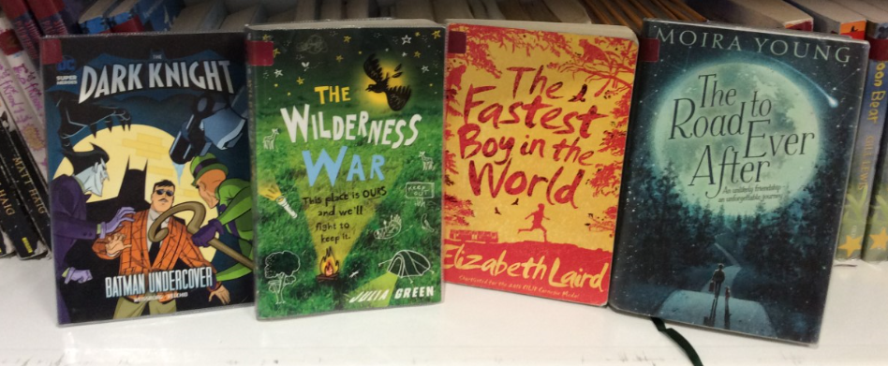
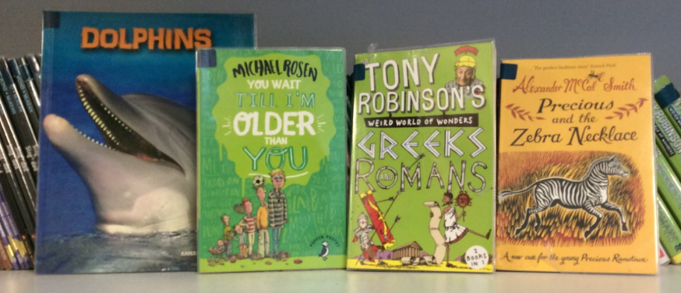
We are very lucky at Thornton to have a really good range of interesting books for Guided Reading and in class libraries. Your child will bring home a Guided Reading book. The teacher helps your child to choose this book to ensure it is at an appropriate level for your child’s current reading ability. They may also have other books that they are reading for pleasure.
Please support your child to take care of these books – keeping them away from leaky drink bottles and younger siblings – and make sure they come back to school every day.
A selection of books from the Guided Reading shelves.

Slide 7
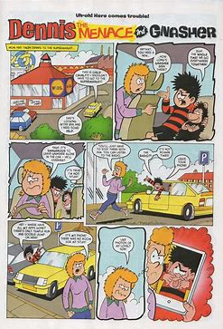
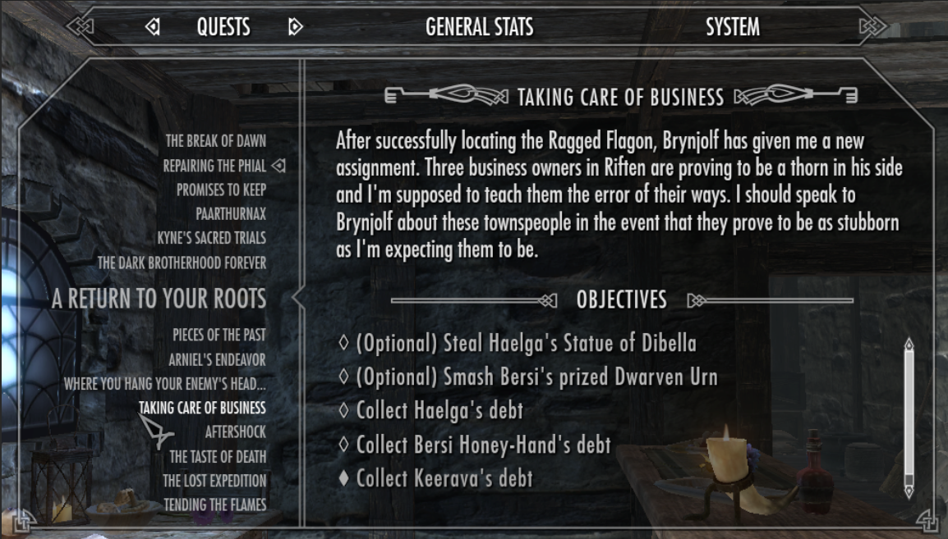
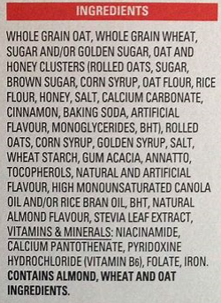

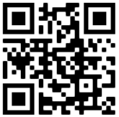
Books are not the only things to read. All reading material is good practice: reading books, comics, online text, cereal boxes and even text in video games will help your child to make progress.
In Years Four, Five and Six, your children will also have access to the Reading Plus website for reading tasks pitched to their current reading ability. In addition, your child will have a class code to access the virtual Epic library at https://www.getepic.com/ This is a fantastic resource with hundreds of books for your child to explore and enjoy.
Scan the QR code to go to the Epic website.

Slide 8
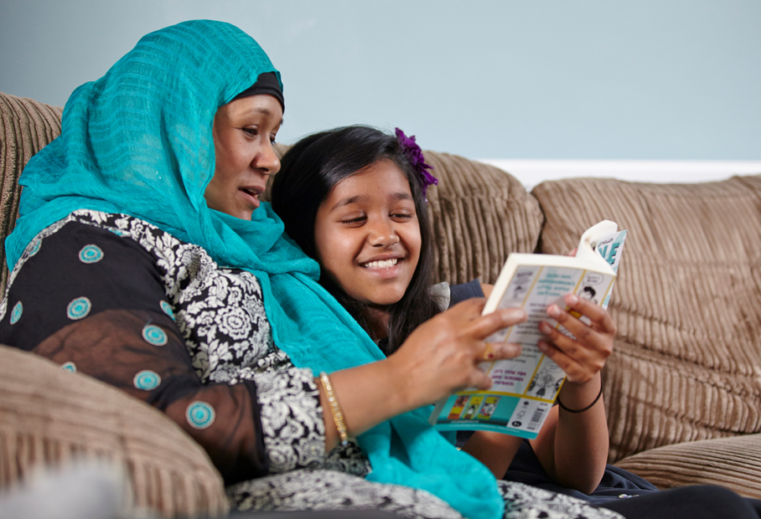
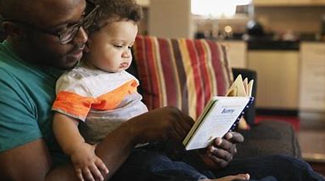
We know that many of our families are large and you also lead busy lives. It might not be easy to find time to read with each of your children every night but it is so important to try.
If you are busy, perhaps an older child can read with a younger child. Maybe all children could read from the same book on one night instead of all reading their own books. Perhaps your child could read alone and tell you about what they read after.
Try to find a way that works for your family.

Slide 9

Sharing a story at bedtime is a great way to settle your child down for a restful sleep. It can be a great way to help set up a healthy bedtime routine as well as helping their reading progress.
Remember that reading regularly at home will have a huge impact on your child’s reading ability, and this supports their writing, understanding and enjoyment. Being able to read confidently and choosing to read because they enjoy it is the best foundation for your child's success throughout their life. The research is clear: children who read for pleasure become successful adults.
Try to set aside a little time for reading at home every day. Getting into a regular routine will help show how important we all believe reading to be.

Slide 10
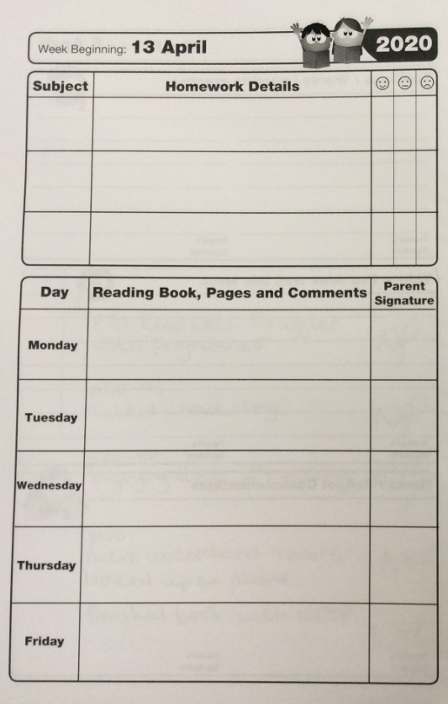
Make sure the diary comes back to school EVERY day – children need them in most lessons.
It is ideal for your child to read with an adult every night. This will give them the best chance to make the best progress.
Sign the diary every time.
Write which pages your child read.
Make a comment about success or difficulties if you can.
It’s fine to not put a comment if you don’t have anything to add. Just sign to show you read with them and write in the page numbers.
NH
NH
p54
p57 – p 62 Read well.
NH
p70 Struggled with
drink and splash.
NH

Slide 11
Sharing a book should be enjoyable. There are lots of ways to keep reading fun while pushing your child’s reading forward.
You could take turns to read aloud: the adult reads a page or paragraph and then the child reads a page. Or you could try using funny voices for when the characters speak. Use a computer image search to help your child understand what you are reading about. It’s a good idea to scan through the text before reading aloud – look for where the sentences end and identify any unfamiliar words.
Children can be reluctant to read. The more you read together, the more they will understand and the more enjoyable the process will become. Learning to enjoy books by listening to a parent or older sibling reading aloud is a good way to help them develop the urge to read independently.

Slide 12


At Thornton we have a saying:
Books are mirrors and windows.
Through reading widely, children can see themselves and their experiences reflected back at them. This helps them make sense of the world and understand themselves.
But books are also a window into other worlds and other experiences. So through reading, they can explore whole universes, broaden their imagination and develop compassion as they learn more about others.
Make sure reading is a part of every day.

