Slide 1
Reading for pleasure
How can you as parents help your child at home?

Slide 2
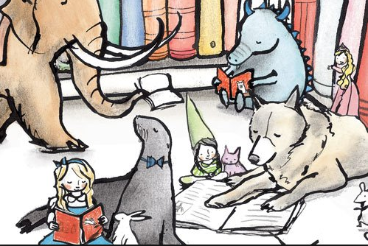

Slide 3
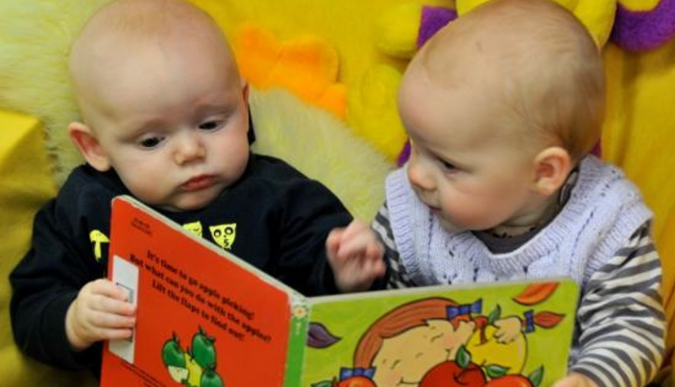
Why read?
A child's success as a reader begins much earlier than the first day of school. Reading, and a love for reading, begins at home.

Slide 4
Things children think

Slide 5
What do studies show?
Reading for pleasure makes a big difference to children’s educational performance.
Evidence suggests that children who read for enjoyment every day not only perform better in reading tests than those who don’t, but also develop a broader vocabulary, increased general knowledge and a better understanding of other cultures.
In fact, reading for pleasure is more likely to determine whether a child does well at school than their social or economic background.

Slide 6
How can parents make a difference?
You can make a huge difference! Parents are the most important educators in a child’s life – even more important than their teachers – and it’s never too early to start reading together.
Even before they're born, babies learn to recognise their parents' voices. Reading to your baby from birth, even for just a few minutes a day, gives them the comfort of hearing your voice and increases their exposure to language.

Slide 7
You’re never too young to read
My child’s too young to start reading yet. How can I point them in the right direction?
Make sure that your child is familiar with language and books so they can see how enjoyable reading is.
Reading aloud to your child, talking about the words and pictures, and sharing ideas about the book
Reading yourself – children who see adults reading, and enjoying it, are much more likely to want to read themselves
Surrounding your child with books – you don't need hundreds of books at home, but go to the library or bookshop regularly to borrow books, spend time together, browse and make choices. In this way, reading becomes a habit.

Slide 8
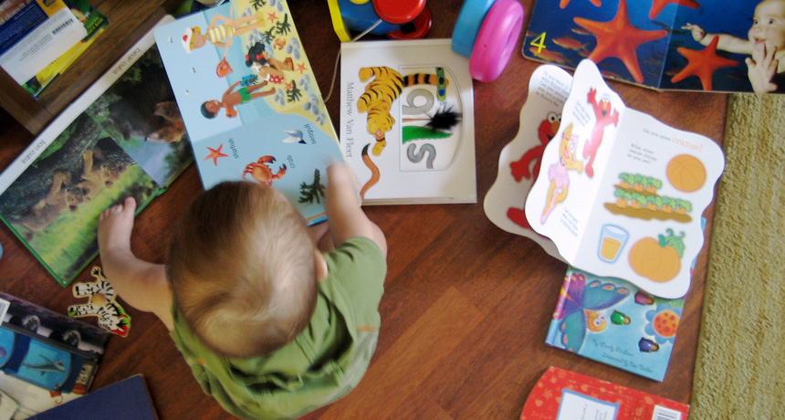

Slide 9
Start from an early age
Cuddle close and sing nursery rhymes, read a story with lots of sound effects, or play peek-a-boo along with a book. This shows your baby how important books are to you, that books come with a loving adult and that books are fun and exciting.
To a young baby, ‘reading’ means holding them in your arms or exploring a soft book.
Once your baby sits up, choose light, sturdy board books with rounded corners, bright pictures and textures to feel.
From six months, babies love lift-the-flap books.

Slide 10
Start from an early age
From nine months, introduce noisy sound books. Be guided by what makes reading fun for you both.
Use the pictures as well as the words. Babies learn by doing: as baby reaches for the pictures, say the words to help build vocabulary.
Be relaxed about what books mean to a baby - a five-minute bouncy sing-song game with an open book is still reading!

Slide 11
Phonics

Slide 12
Phonics
With phonics, children are taught to read by learning the phonemes (sounds) that represent letters or groups of graphemes (letters). With this knowledge, children can begin to read words by learning how to blend the sounds together.
Unlocking how this alphabetic code works means they can learn to decode any word. For example, when taught the sounds /t/, /p/, /a/, /i/ and /s/ early on, children can read words such as it, is, tap, tip, pat, sip and sat by blending the individual sounds together to make the whole word.

Slide 13
Phonics definitions
Phoneme: Distinct units of sound; s, a, t, p.
Blending: This is merging the sounds together to create a word; c-a-t.
Segmenting: This is the opposite of blending. The children can break it up into the phonemes. This helps with spellings.
Digraph: Two letters that join together to make a sound; such as ck, ng, ll.
Trigraph; Three letters than join together to make a sound; such as igh, air, ear.
Tricky words: These follow no rules and cannot be sounded out correctly.

Slide 14
Phonics
These words can also be broken down (segmented) into their phonemes for spelling. For example, the word ‘sat’ has three phonemes, /s/, /a/ and /t/ which the children learn to write with the three graphemes (letters) ‘s’, ‘a’ and ‘t’ that they have been taught.
They will also be taught to read words – such as ‘once’, ‘was’ or ‘have’ – which don’t follow the phonic ‘rules’. They’ll build up a stock of these tricky words that they can recognize straight away.

Slide 15
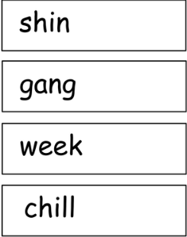
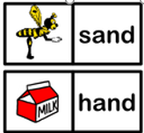
Lets have a go at blending and segmenting.

Slide 16
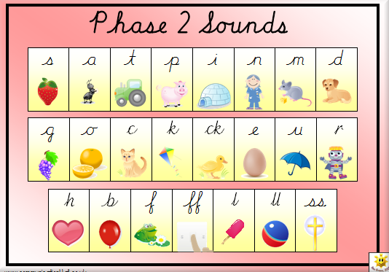
Say the sounds correctly
It’s important that the sounds are pronounced correctly, as they would sound in speech. Try not to add ‘uh’ to consonant sounds, such as /t/ and /p/, as this makes it trickier to blend the sounds together into words.

Slide 17
Practice
Practice! Encourage your child to use their phonic knowledge when they are practising their reading. Make sure that they look at each letter in turn, all through each word. Encourage them to work out the sounds and then blend them together to make the whole word. Praise them for trying to use all the letters rather than guessing from just the first letter or the picture.

Slide 18
Don’t be scared make it fun!
Phonics can seem daunting for parents who were probably taught to read in a rather different way. However, simple games such as ‘I spy’ are great for helping reading, because the children have to listen to sounds. Say, “I spy, with my little eye, something that begins with (for example) the sound ‘f-f-f ’” Look at the ‘football’ or the ‘fridge’. Make sure you refer to the first sound (not the first letter). Take it in turns, with your child saying, “I spy…”.
Making it fun is the key!

Slide 19
Reading comprehension

Slide 20
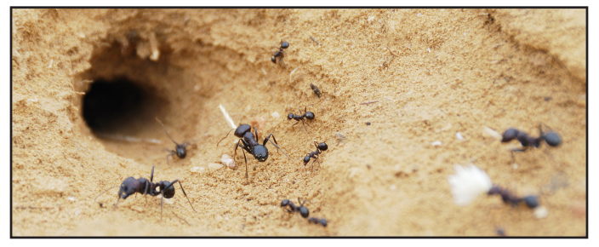
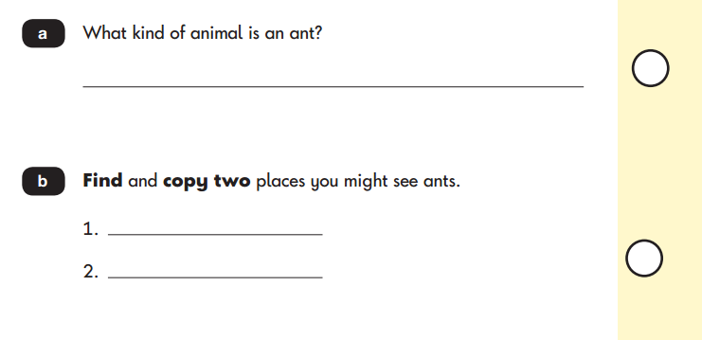
Example

Slide 21
Reading comprehension
Reading comprehension is the ability to understand what is being read. Children must be able to read the words in the text and combine it with what they already know to “think” about what the author is trying to say.
Reading comprehension is NOT just finding answers in the text. Children must be able to interact with the text, think deeper, analyse, predict and be able to summarise what is written.

Slide 22
How can you help with reading comprehension?
Look at the front cover!
Before reading a story with your child, look at the cover.
Read the title and look at the picture if there is one.
Talk about what you already know about the topic and try to make a connection with what your child already knows.
For example, before reading a book on “Desert Animals”, you can talk about what your child already knows about the desert and animals that live in different areas. Activating this “prior knowledge” helps with reading comprehension.

Slide 23
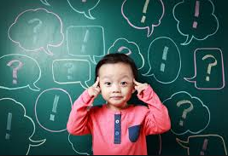
Asking questions
While reading, help your child make connections with the text. When you ask your child questions such as “how would you feel if that happened to you?” or “does this part of the story remind you of our holiday on the beach?” you are having your child make a “text-to-self” connection.
Encourage your child to make predictions while reading. (“What do you think will happen next?” “Let’s keep reading and see”).
Model thoughtful question asking while reading. Stay away from yes/no questions. Questions such as “Why do you think the boy was afraid?” is preferable to “Was the boy afraid?”

Slide 24
How long should we read for?
Be guided by how long they will listen. For younger children this may be quite short periods of time, while slightly older children may be readier to listen for longer.
As for how often, there’s no right answer, but many experts suggest a routine helps. For school-age children, a bedtime story can be a nice way for you to spend a small amount of time together and wind down after a busy day. For pre-school children, shorter bursts of reading throughout the day may be a good idea but, again, be guided by how long your child will listen.

Slide 25
What if my child doesn’t like reading?
Make sure your child isn’t tired, hungry or desperate to watch their favourite TV programme when you read to them. Sit with them for a short time every day and read a book with them on a subject that interests them, whether that’s cars, animals or sports.
Don’t expect them to read it for themselves. Just show them how interesting it is to be able to read so that they want to do it for themselves. • For many children, especially boys as they get older, non-fiction books are more interesting than fiction, so it may be as simple as changing the type of books you are reading together.
Give plenty of praise. Let your child know how pleased you are when he or she looks at a book.
Children really do develop at their own rates when it comes to reading.

Slide 26
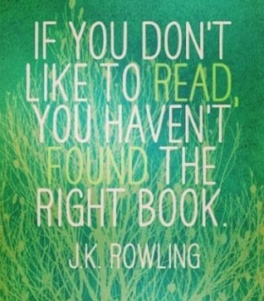

Slide 27
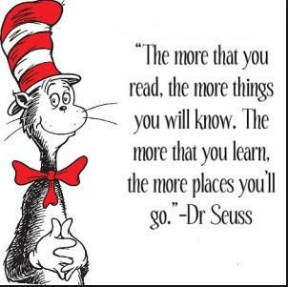
Read everyday!
Little and often is the key to reading.
Allow your child to choose their own book.
Don’t force your child to read; if your child is not enjoying the back encourage them to choose a different book.
Make reading part of your family time.

Slide 28
Owl diaries and reading records
Owl Diaries
Check as often as possible. At least twice a week.
This is where the children record all of their homework.
Reading Records
When you hear your child read please write a comment or sign your name in their reading record. This helps with communication and it shows the teacher how much your child is reading at home.
If you read with your child, other than their school reading book, this can also be recorded in there.

Slide 29
Lets go and see our new thornton library

