Slide 1
Owlets Maths Workshop Friday 10th February 2017
Exploring Number

Slide 2
Aims
Understand the aims of the current National Curriculum for Mathematics
How we teach Maths at Thornton
Understanding numbers to 100
How you can support your child at home with developing ‘number sense’.

Slide 3
Current National Curriculum- What's changed?
Higher expectations
Deep conceptual understanding of number
Fewer things but in more depth
Pupils need to build firm foundations to become Secondary ready

Slide 4
How do we teach Maths at Thornton?
Singapore Maths Model

Slide 5
End of Year 1 Expectations (NC)
Pupils should be taught to: ▪
count to and across 100, forwards and backwards, beginning with 0 or 1, or from any given number
count, read and write numbers to 100 in numerals; count in multiples of twos, fives and tens ▪
given a number, identify one more and one less
identify and represent numbers using objects and pictorial representations including the number line, and use the language of: equal to, more than, less than (fewer), most, least ▪
read and write numbers from 1 to 20 in numerals and words.

Slide 6
Let’s have a go!
Show me number 27. Which number comes before? Which number comes after?
What is 10 more than 45?
What is 10 less than 67?
Count back from 89 6 times. What number do you land on?
I’m thinking of a number. It is a odd number between 10 and 20. Which numbers could I have in mind?

Slide 7
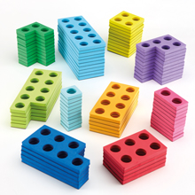
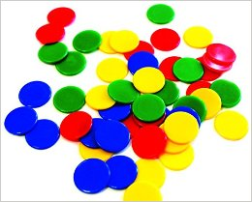
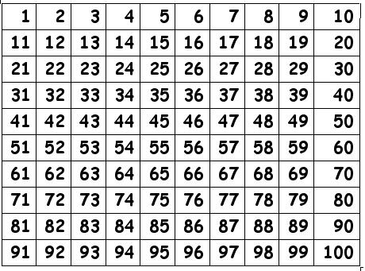
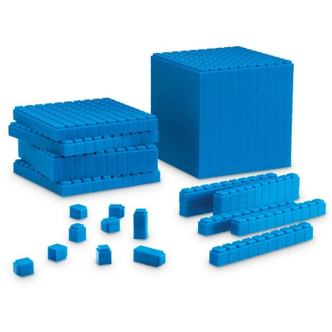
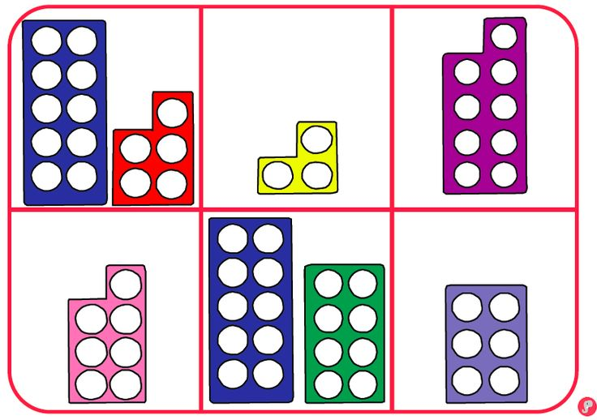
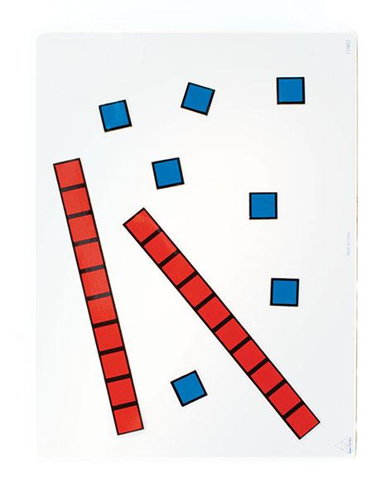
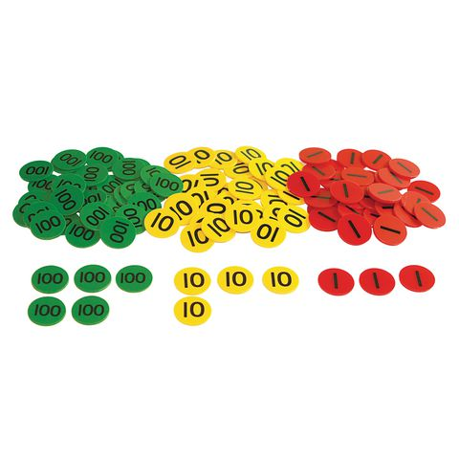
Concrete and Pictorial

Slide 8
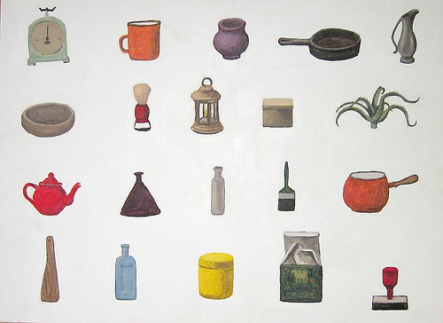
Convince me that 13 is less than 20.
Always/Sometimes/Never: A number with 9 in the ones is always bigger than one with 6 in the ones.
Show me (find/ write) the number that will label this group of objects.
Can you change this pot so that it has enough pencils for 8 children?

Slide 9
How can I help my child at home?
Use a 100 square to practise counting on an back.
Recite numbers to a 100 (forwards and backwards)
Count everyday objects: clothes on the washing line, plates on the tables, pairs of socks to count in 2’s.
Talk about the value of numbers. 57 has 5 tens and 7 ones.

Slide 10
‘The answer is only the
beginning…’

